Slide 1

EE-371 : Control Systems
Lecture # 37, 38
Time Domain Analysis
3.1 Introduction, 112
3.2 Some Observations, 112
3.3 The General State-Space Representation, 116
3.4 Applying the State-Space Representation 118
Textbook: Chapter # 03 (5th edition)
Text Book: Control Systems Engineering by Norman S. Nise 5th Edition
Instructor: Ms Neelma Naz
Class: BEE 12 C/D
School of Electrical Engineering and Computer Science
Department of Electrical Engineering

Slide 2
Two Approaches for Analysis and Design of Control Systems
The classical, or frequency-domain, technique
Convert differential equation to a transfer function through LT
Generates a mathematical model of the system that algebraically relates the output to the input
Applicable to relatively simple LTI, SISO systems
The state-space technique (modern, or time-domain, approach)
Applicable for modeling, analyzing, and designing a wide range of systems.

Slide 3
Terminologies and the Concepts used in State-space Technique
State variables
State vector
State space
State equations
Output equation
Linear combination
Linear independence
System variable

Slide 4








The General State-Space Representation
x = state vector
= time derivative of the state vector
u = input or control vector
A = system matrix
B = input matrix
D
B
C
y = output vector
A
C = output matrix
D = feed-forward matrix

Slide 5
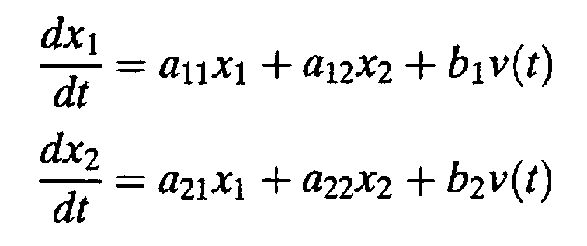
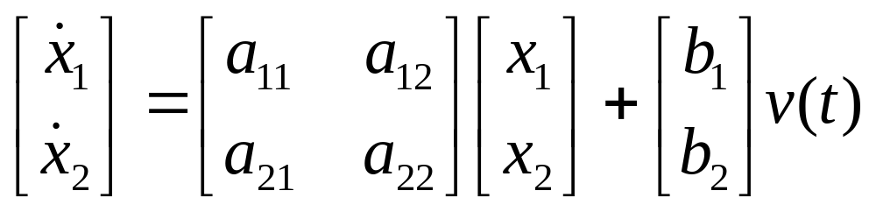
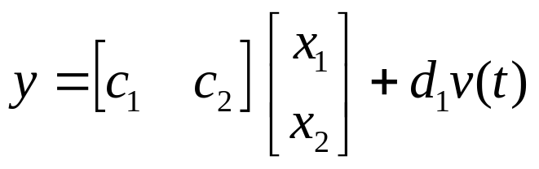

The General State-Space Representation

Slide 6
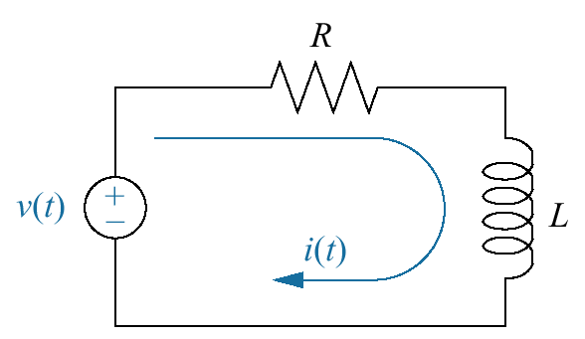
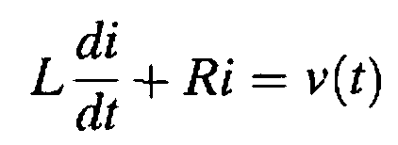

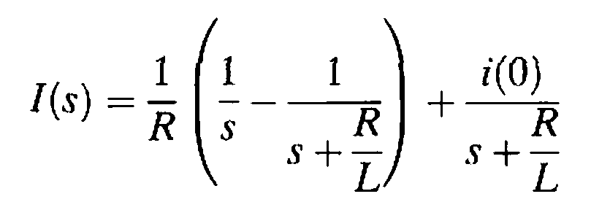
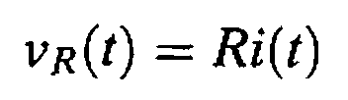
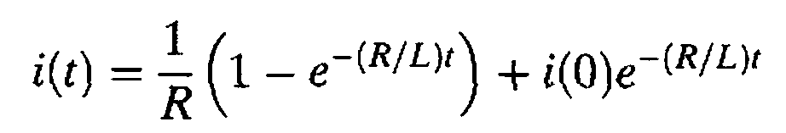
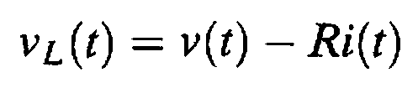
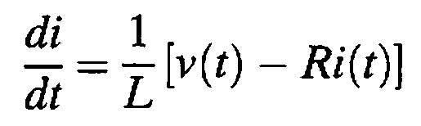
Loop Eq
State Equation
Taking LT
All other variables can be expressed in terms of :
i(t) (the state variable) and
v(t) (the input)
For step input
State-space representation
Inverse LT
Output Equations
i(t) can be determined if
i(0) and v(t) are known

Slide 7
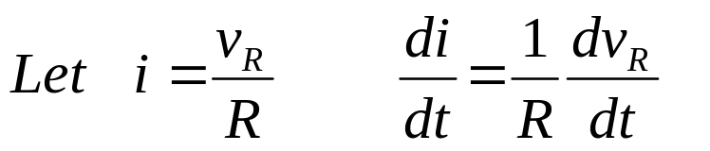
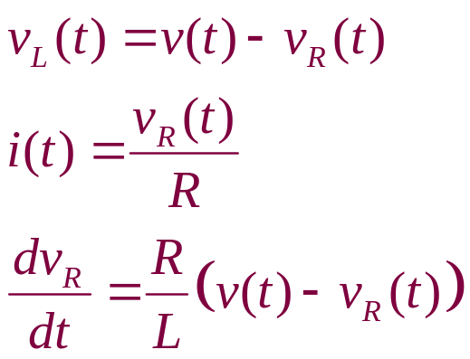
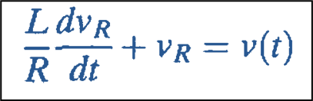

Alternate description of the network dynamics
All other network variables can now be written in terms of the state variable, v_{R}(t), and the input, v(t)
Choice of state variables is not unique

Slide 8
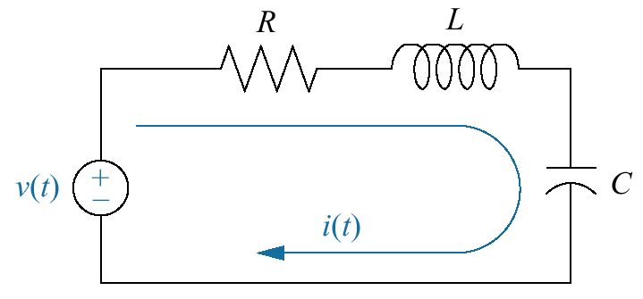
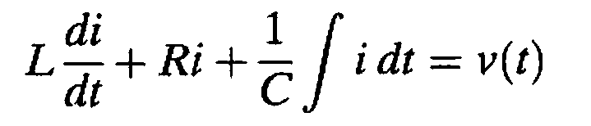
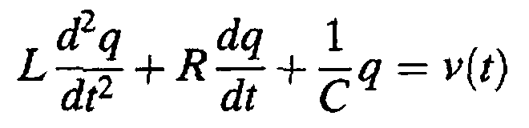
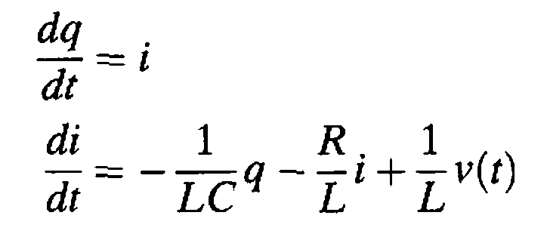
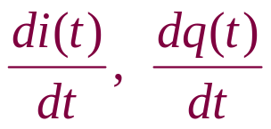
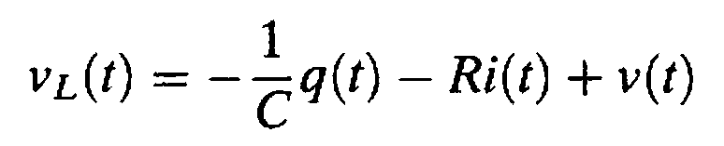
The loop equation
using i(t) = dq/dt, we get
The network is of second order, two simultaneous, first-order differential equations are needed to solve for two state variables
Network variables:
v_{R}(t), v_{C}(t), v_{L}(t), i(t), q(t),
State-space representation
select i(t) and q(t),the charge on the capacitor, as the two state variables
v_{L}(t) is a linear combination of the state variables, q(t) and i(t), and the input, v(t)

Slide 9
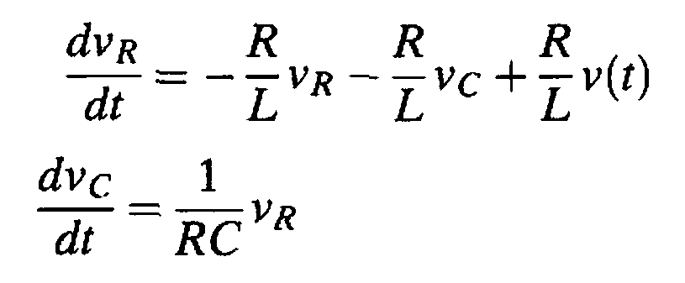





The loop equation
Alternate choice of state variables

Slide 10
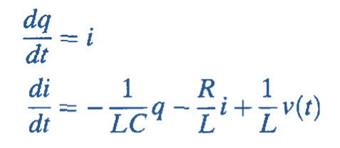

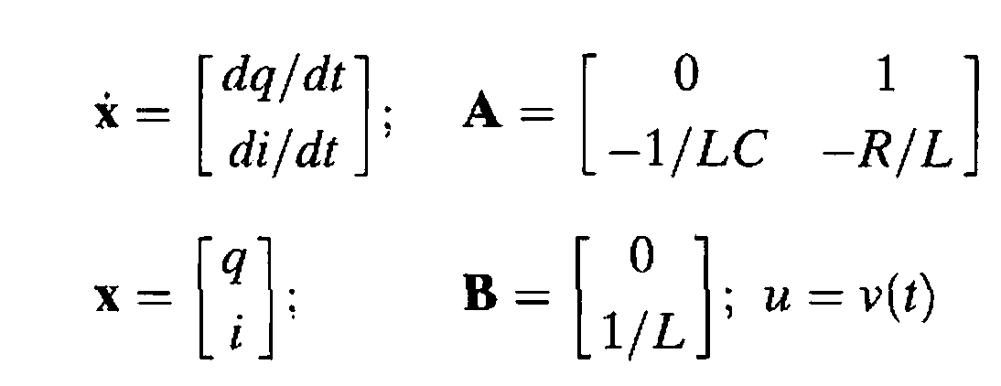
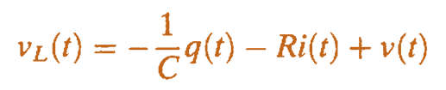

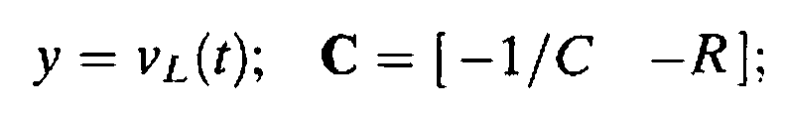
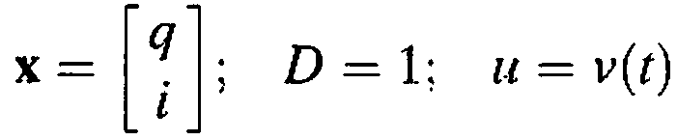
State Equation
The state and output equations can be written in vector-matrix form,
Output Equations
The output equation, can be written as

Slide 11
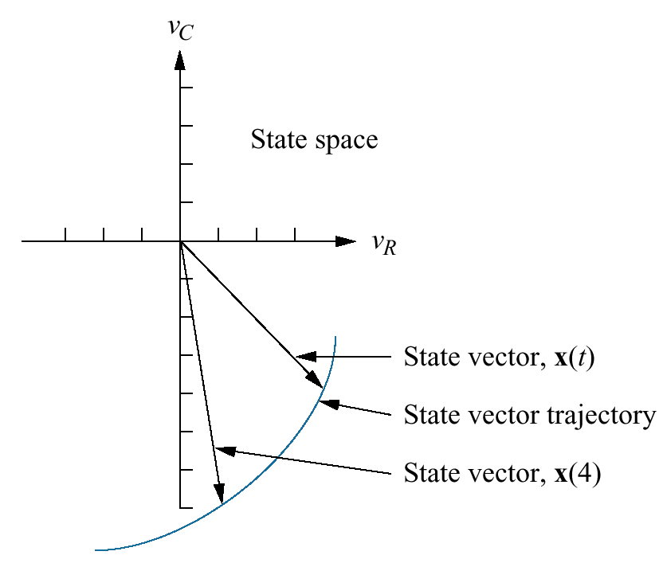
Graphic representation of state space and a state vector

Slide 12
Observations
For a system with many variables, we need to use differential equations only to solve for a selected subset of system variables
The remaining system variables can be evaluated algebraically from the variables in the subset
The selected subset of system variable are the state variables
System variables:
v_{R}(t), v_{C}(t), v_{L}(t), i(t), q(t),
Selected subset of system variables
i(t) and q(t)

Slide 13
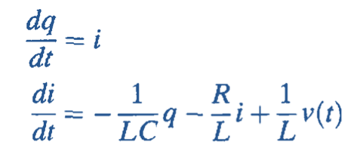
For an nth-order system, we write n simultaneous, first-order differential equations in terms of the state variables.
We call this system of simultaneous differential equations the “state equations”.
If we know the initial condition of all the state variables at t₀ as well as the system input for t > t₀, we can solve the simultaneous differential equations for the state variables for t > t₀.

Slide 14
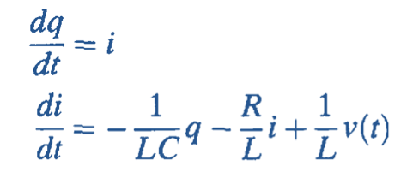
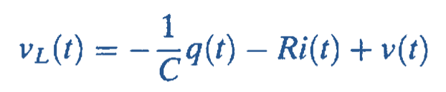
The state variables are algebraically combined with the system's input to find the remaining system variables for t > t₀.
This algebraic equation is the output equation.
The state equations and the output equations represent the system.
This representation of the system is called state-space representation.

Slide 15
Applying the State-Space Representation
Select the state vector, which must be chosen according to the following considerations:
A minimum number of state variables must be selected as components of the state vector. This minimum number of state variables is sufficient to completely describe the state of the system.
2. The components of the state vector must be linearly independent.

Slide 16
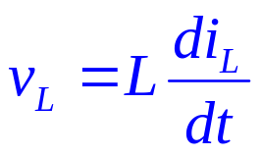
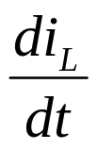
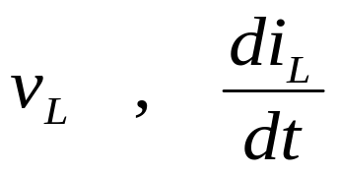
Linear Independence
If x₃ can be expressed in terms of x₁ and x₂ as:
x₃ = 5x₁ + 4x₂
then x₃ is not linearly independent of x₁ and x₂
Variables and their successive derivatives are linearly independent.
For example, the voltage across an inductor, v_{L}, is linearly independent of the current through the inductor, i_{L}.
v_{L} is linearly dependent on di_{L}/dt
v_{L} cannot be evaluated as a linear combination of the current, i_{L}
i_{L} ,
v_{L ,} i_{L}

Slide 17
Some definitions
System variable : any variable that responds to an input or initial conditions in a system
State variables : the smallest set of linearly independent system variables such that the values of the members of the set at time t0 along with known forcing functions completely determine the value of all system variables for all t ≥ t0
State vector : a vector whose elements are the state variables
State space : the n-dimensional space whose axes are the state variables
State equations : a set of first-order differential equations with n variables, where the n variables to be solved are the state variables
Output equation : the algebraic equation that expresses the output variables of a system as linear combination of the state variables and the inputs.

Slide 18
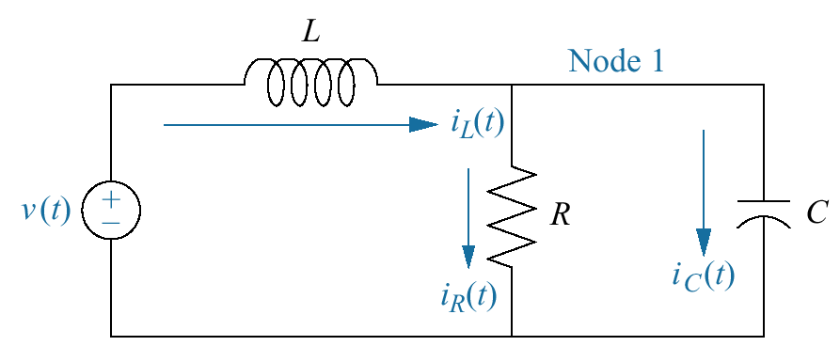
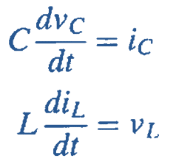
Example 3.1
Representing an Electrical Network
PROBLEM: Given the electrical network shown in the Figure, find a state-space representation if the output is the current through the resistor.
SOLUTION:
Label all of the branch currents
Write the derivative equation for all energy storage elements
choose the state variables as the quantities that are differentiated.
The right-hand sides of these Eqs. should be linear combinations of the state variables and the input

Slide 19
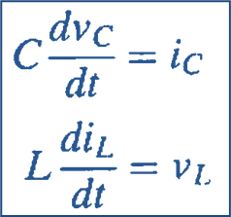
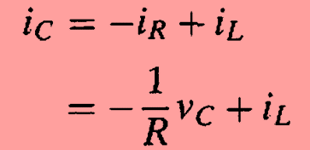
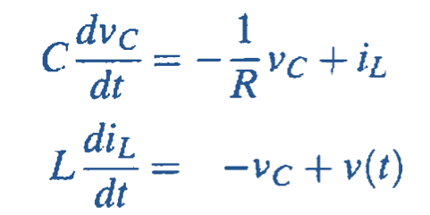

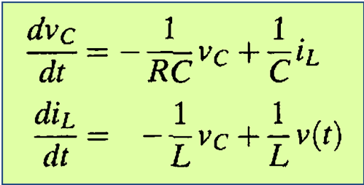
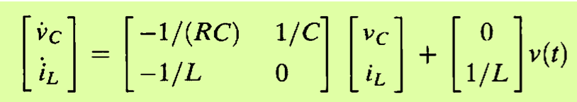
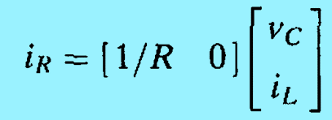
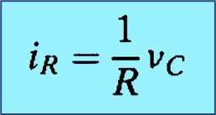
Apply network theory to obtain i_{c} and v_{L} in terms of the state variables, v_{c} and i_{L} and the input v(t).
At Node 1
Writing loop eq for outer loop

Slide 20
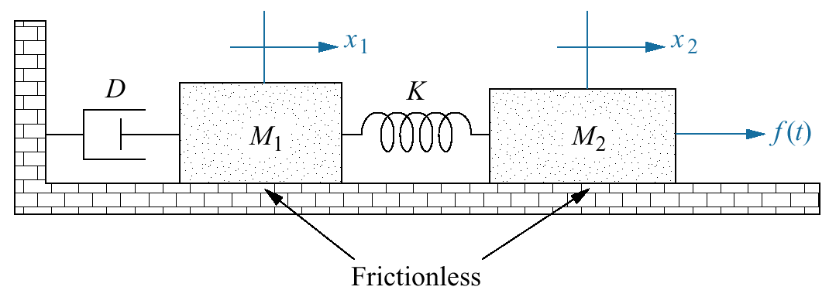
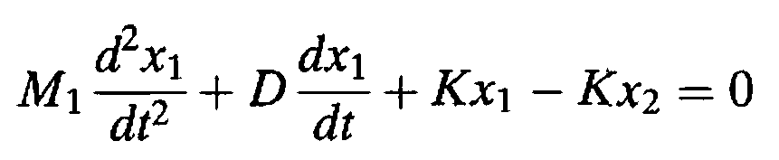
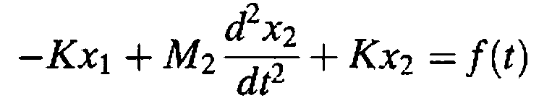
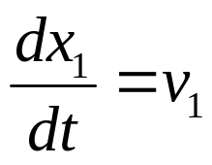
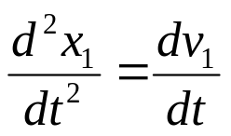
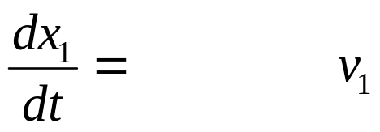
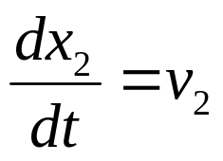
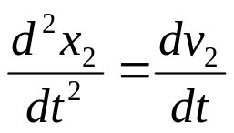
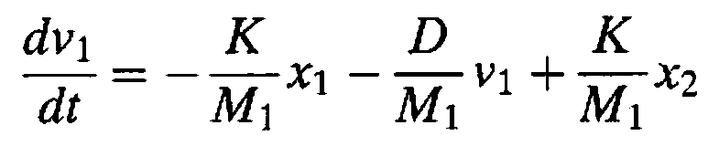


Example 3.3
Representing a Translational Mechanical System
PROBLEM: Find the state equations for the translational mechanical system shown in the Figure.
SOLUTION:
x₁, v₁, x₂, v₂ are the state variables

Slide 21




Slide 22
Obtaining State equations from an n^{th} order differential equation

Slide 23






Dynamic Equations
Transfer Function
Choose the output, y(t), and its successive derivatives up to (n-1)th derivatives as the state variables
Differentiating both sides
= x₂
= x₃
= x₄

Slide 24




State vector
phase-variable form of the state equations

Slide 25




Example 3.4
Converting a Transfer Function with Constant Term in Numerator
PROBLEM: Find the state-space representation in phase-variable form for the system shown in the figure
SOLUTION:
By cross-multiplying we get
By taking the inverse Laplace transform, the differential equation is found

Slide 26






Choosing the state variables as successive derivatives
State Equations
Output Equation

Slide 27



Equivalent block diagram showing phase-variables

Slide 28

Transfer Function with a polynomial in numerator
Order of the numerator is less than that of the denominator
The numerator and denominator can be separated into two cascaded transfer functions
The first transfer function is converted to the phase-variable representation in state space with x₁ as output

Slide 29




The second transfer function may expressed as
Taking inverse Laplace transform, we get:
or
The output y(t) is a linear combination of the state variables

Slide 30




b₂
C(t)
r(t)
b₁
x₃
x₂
x₁
1/a₃
b₀
-
-
-
a₂/a₃
a₁/a₃
a₀/a₃

Slide 31
Converting from State Space to a Transfer Function

Slide 32







The state and output equations are given as
Substituting for X(s) in Eq (2)
Taking the Laplace transform assuming zero initial conditions
(1)
(2)
Transfer function matrix
From Eq (1)
If U(s) = U(s) and Y(s) = Y(s) are scalars, the transfer function can be found

Slide 33




Example 3.6
State-Space Representation to Transfer Function
PROBLEM: Given the system defined by the following state and output Equations, find the transfer function, T(s) = Y(s)/U(s), where U(s) is the input and Y(s) is the output.
SOLUTION:
The transfer function matrix is:

Slide 34









Slide 35


Home Assignment
Convert the given transfer function for the mechanical translational system to the state-space representation in phase-variable form.
Draw equivalent block diagram showing the phase variables.

Slide 36






4.10: Laplace Transform Solution of State Equations
State equations
Output equations

Slide 37




Eigen values and Transfer Function Poles
a nonzero solution exists if
The eigenvalues, λ_{i}, of matrix A can be found by solving the polynomial

Slide 38







Let the output, Y(s), and the input, U(s), be scalar quantities Y(s)
and U(s), and the initial state vector x(0) is equal to 0
The roots of the denominator are the poles of the system

Slide 39



Exercise 4.9
PROBLEM: Given the system represented in state space by
Do the following:
a. Solve for y(t) using state-space and Laplace transform techniques.
b. Find the eigenvalues and the system poles.

Slide 40










Solution
a.
b.

Slide 41

???

